Slide 1
The 104 Best Things to Do in D2L
Thomas J. Tobin
Northeastern Illinois University

Slide 2
Covering 104 Things in an Hour? How about 8 minutes?

Slide 3
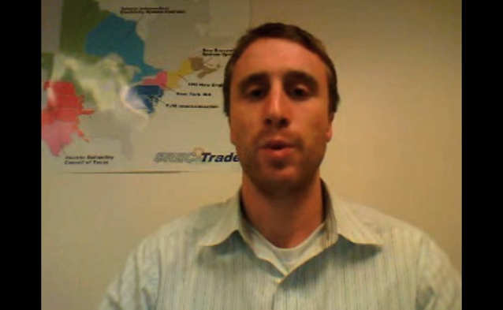
ice breakers
1: Discussion Topic | 2: Audio Intros
3: 10-Second Video | 4: Most Recent Picture

Slide 4
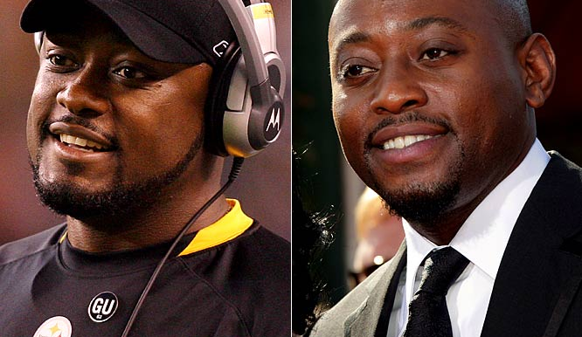
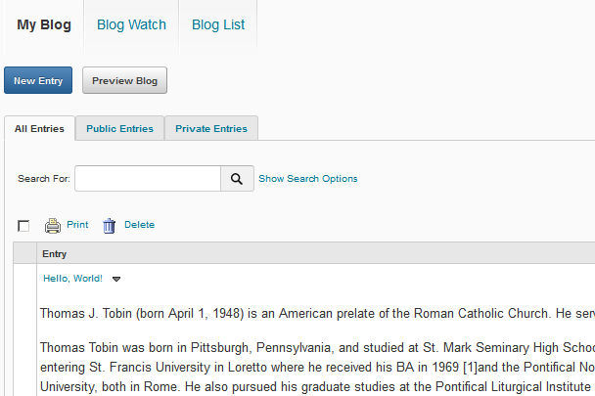
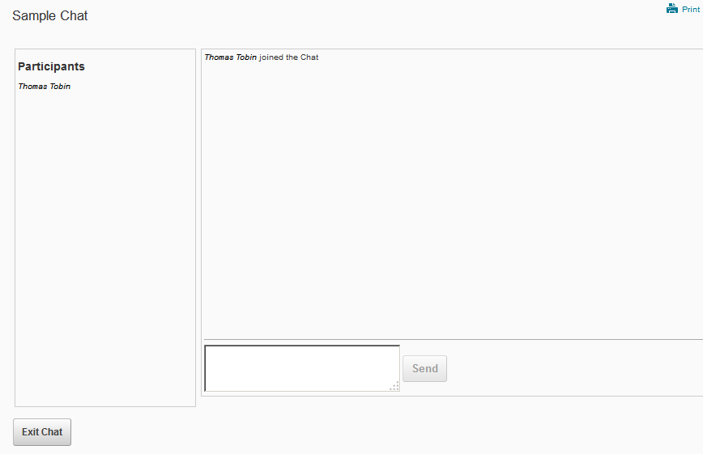
ice breakers
5: Separated at Birth? | 6: Cartoon Me
7: Blog Sharing | 8: Real-Time Chat

Slide 5
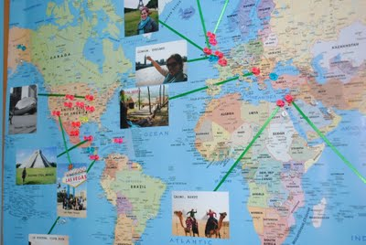
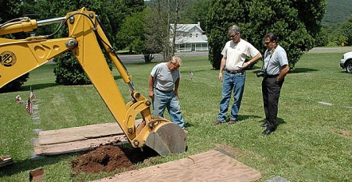
ice breakers
9: Farthest, Closest | 10: First Job
11: Not My Picture | 12: YouTube
13: Rhyming Introductions: Introduce yourself in rhyming verse.

Slide 6
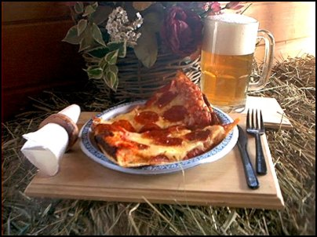
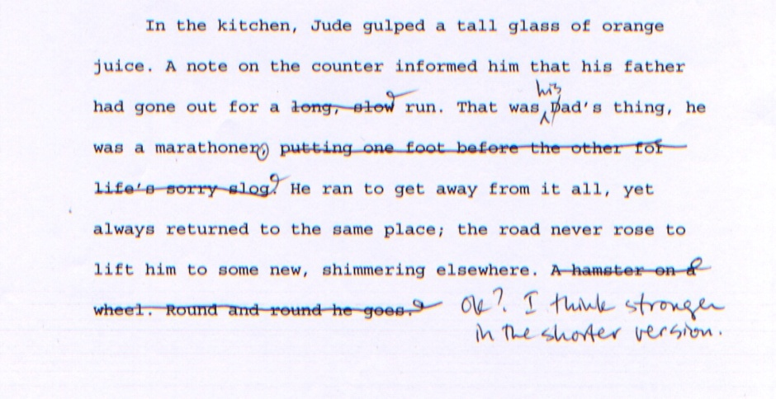
student engagement
14: Virtual Pizza-n-Beer | 15: Peer Lead
16: One-Paragraph Report | 17: Super-Mini Quiz

Slide 7
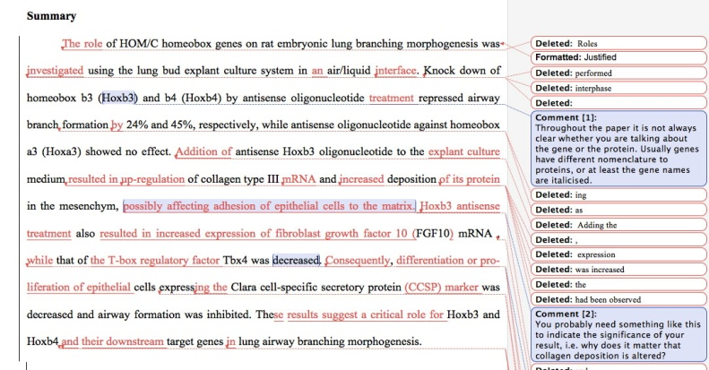
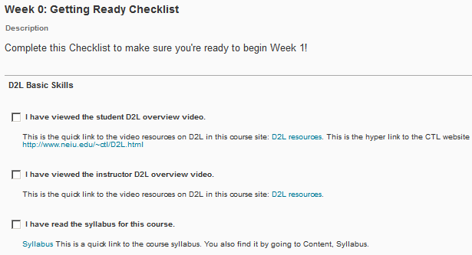
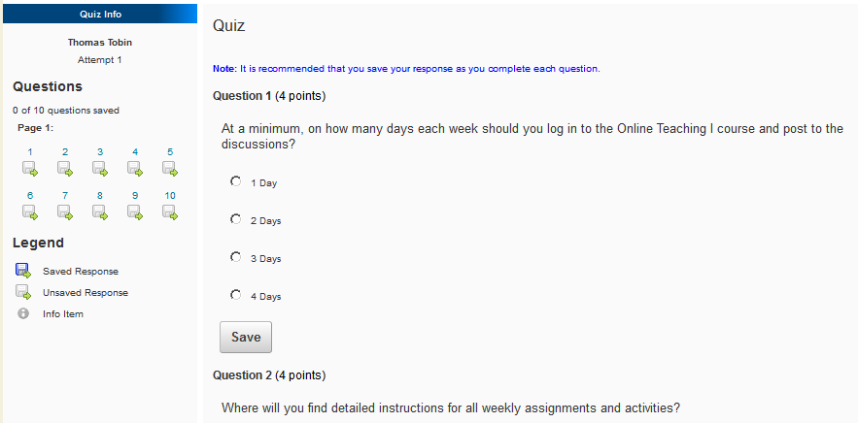
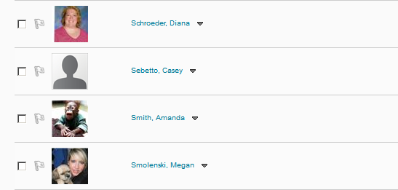
student engagement
18: Re-Write It | 19: Checklists
20: Syllabus Quiz | 21: Classlist “Tag”
22: Assignment Re-Write: Craft the instructions in your own style (or someone else’s).

Slide 8
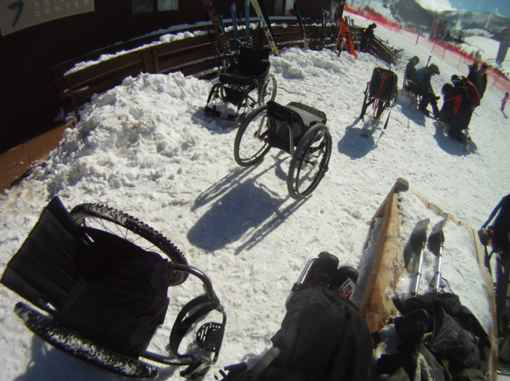
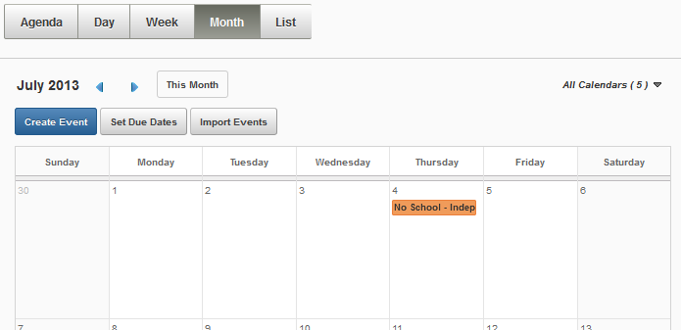
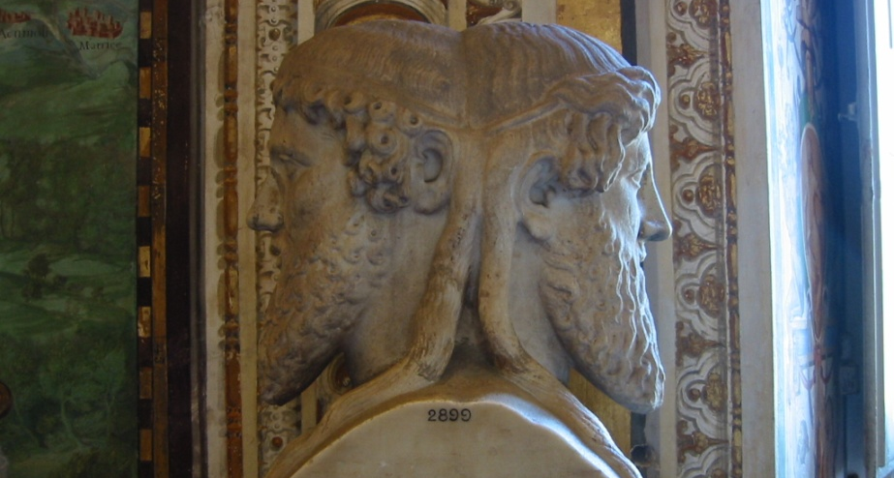
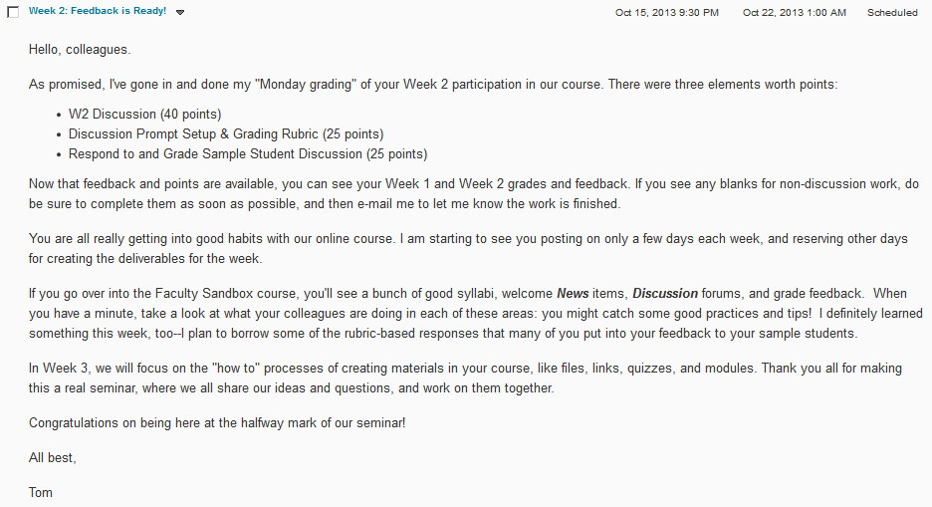
student engagement
23: Take Me with You | 24: Calendar Items
25: Devil’s Assignment | 26: Progress-Check News

Slide 9
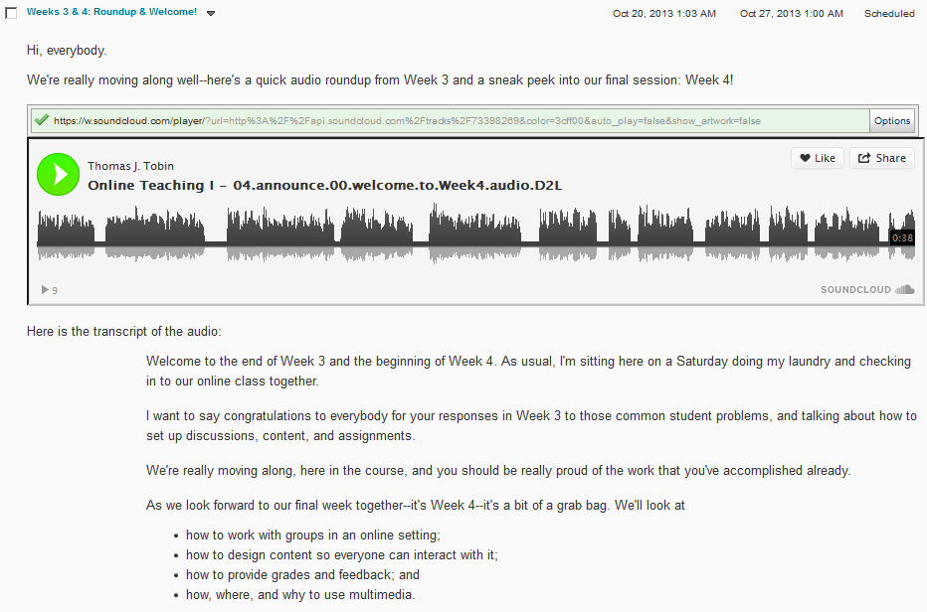
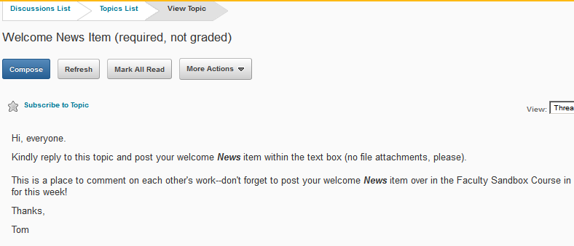
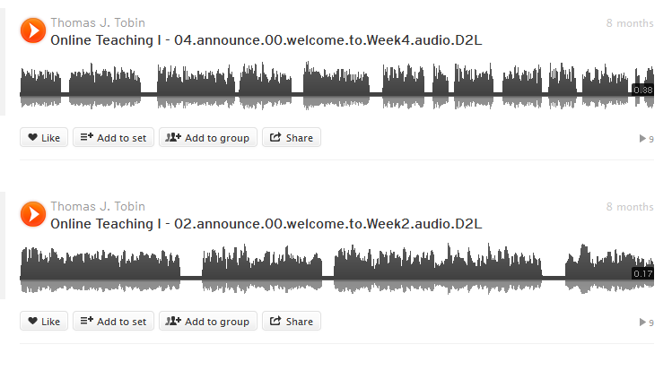
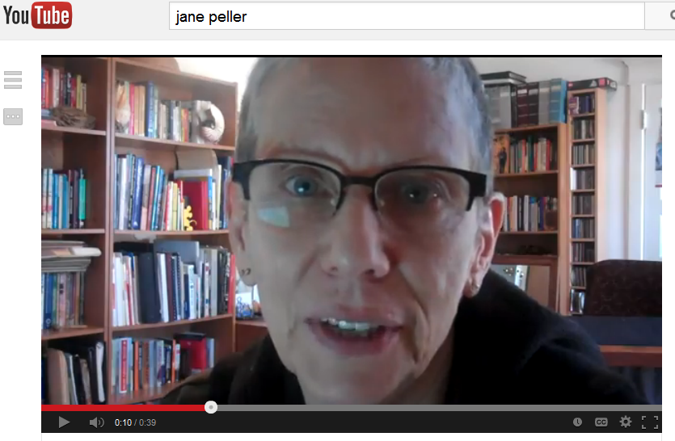
instructor presence
27: News Items | 28: Discussion Posts
29: Audio Clips | 30: Video Check-Ins
31: “Voice Mail”: Leave students audio messages no longer than 20 seconds. Beep!

Slide 10
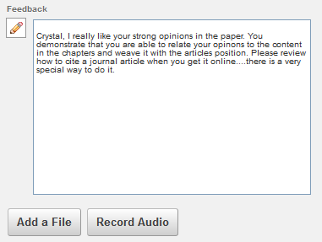
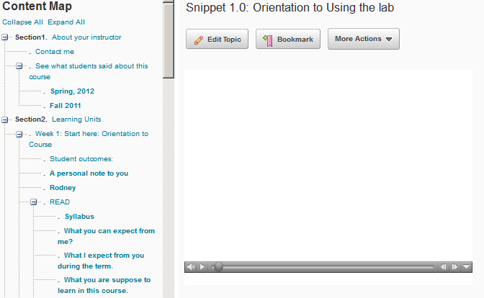
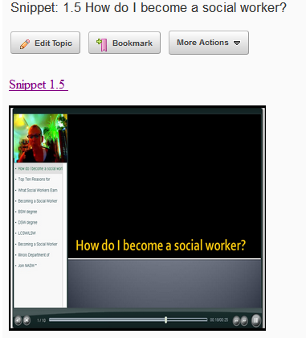
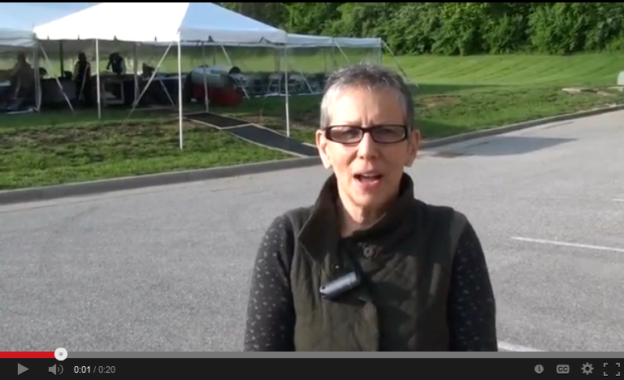
instructor presence
32: Audio Assignment Feedback | 33: Audio Lecture “Bits”
34: Video Lecture “Bits” | 35: Video Postcards

Slide 11
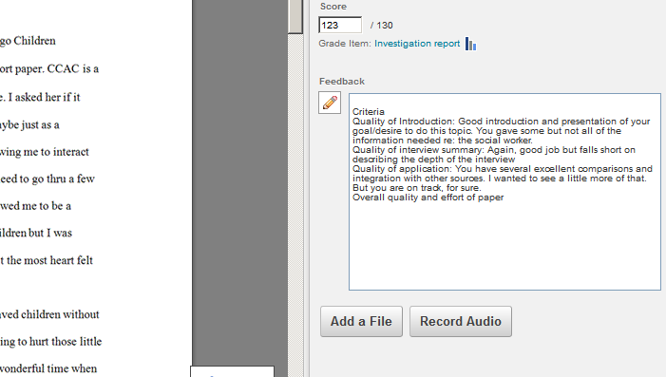
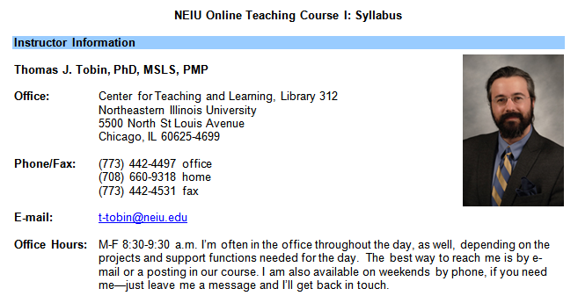
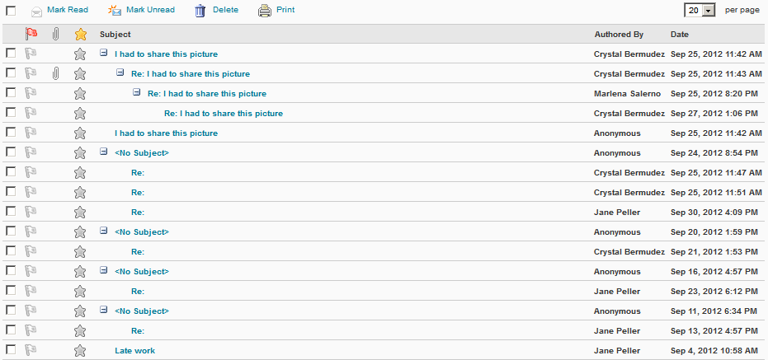
instructor presence
36: Discussion Wrap-Ups | 37: Personalized Feedback
38: My Picture in the Syllabus | 39: Posting Everywhere at Least Once

Slide 12
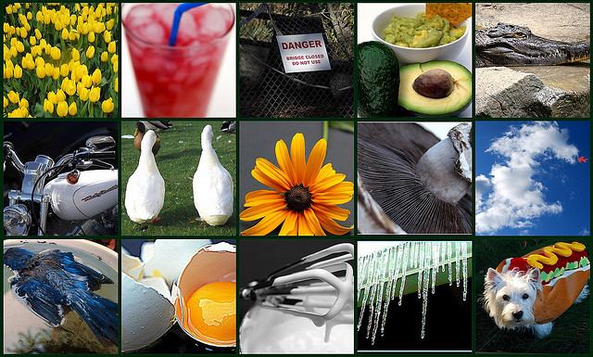
interactivity
40: Scavenger Hunt | 41: Telephone Game
42: Thought Exercises | 43: Switch Thinking

Slide 13
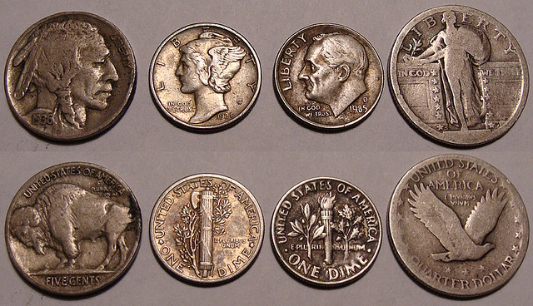
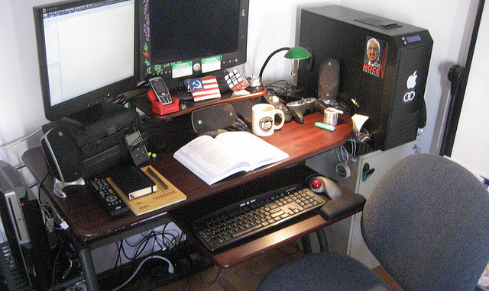
interactivity
44: Opposites Discussion | 45: Stop and Think
46: Butts Out of Seats | 47: Look Around You

Slide 14
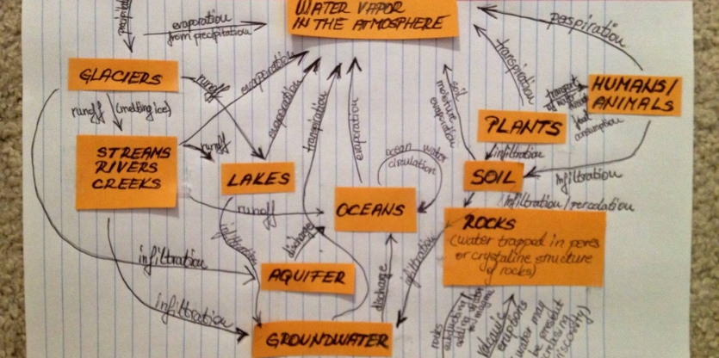
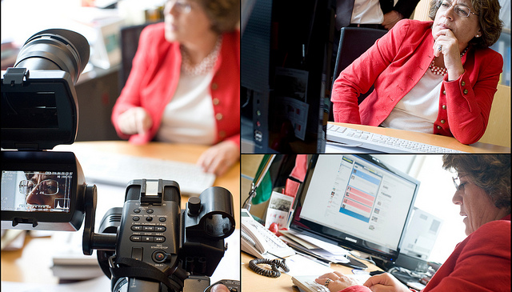
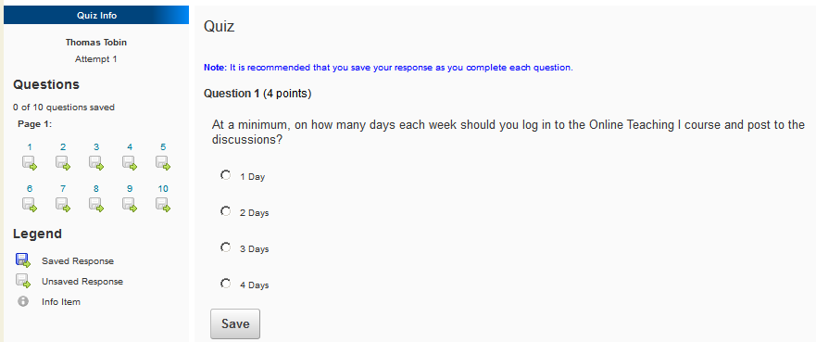
interactivity
48: Build, Photo, Post | 49: Non-Boring Groups
50: Chat | 51: Quizzes about Quizzes
52: Must Post to See Others:

Slide 15
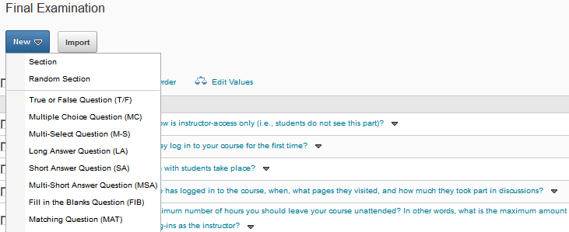
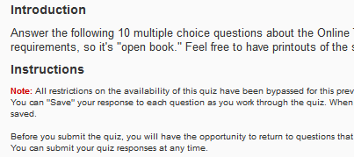
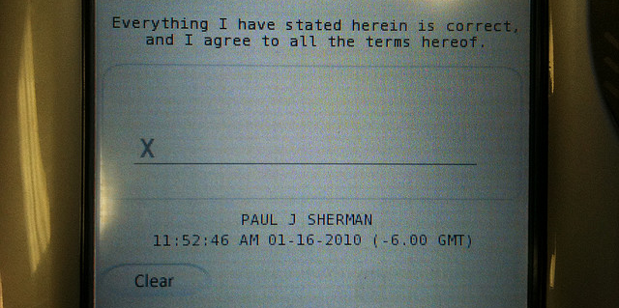
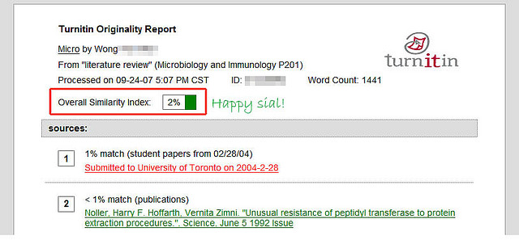
academic integrity
53: 3-to-1 Pools | 54: Sanction Statements
55: Sign Here, Please | 56: Plagiarism Checking
57: Special Browsers:

Slide 16
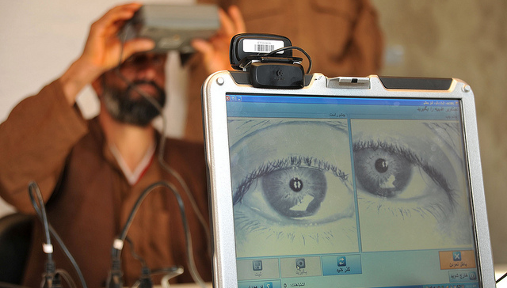
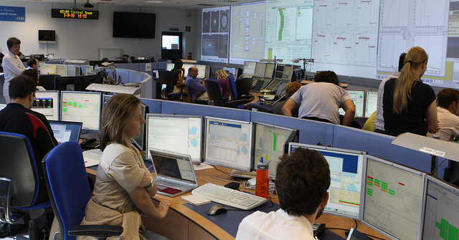
academic integrity
58: Trust | 59: Identify
60: Verify | 61: Real-Time Monitoring

Slide 17
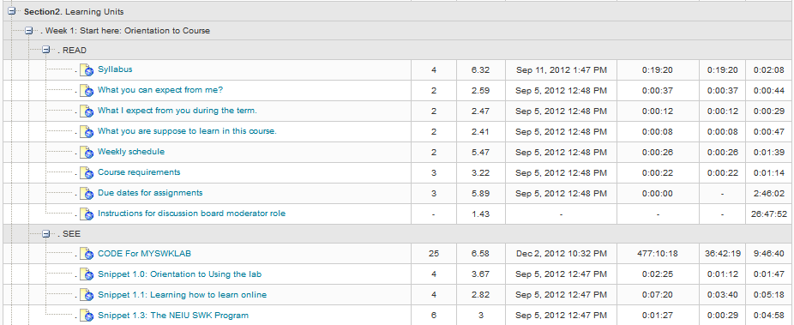
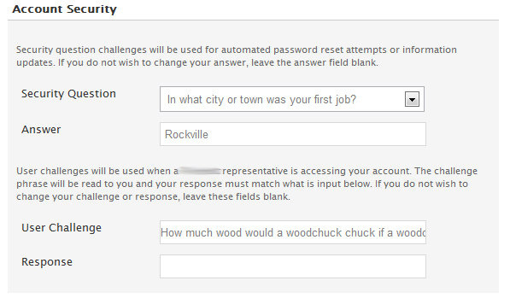
academic integrity
62: View User Progress | 63: Challenge Questions
64: Design for Application | 65: Expect Resource Use

Slide 18
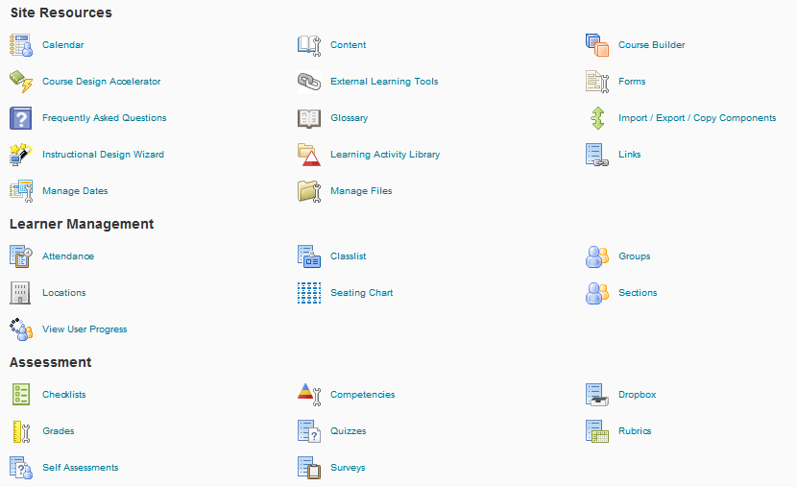
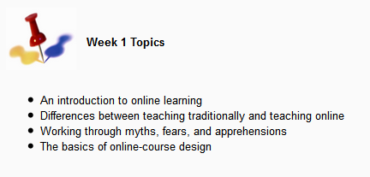
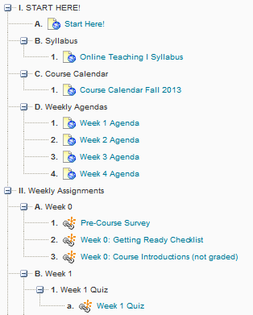
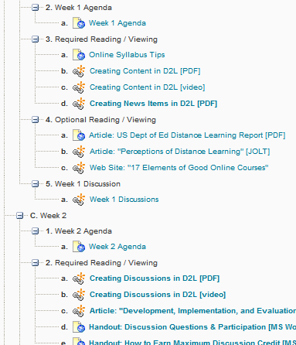
usability
66: Pick 3 Elements | 67: Text Appearance
68: Follow This Path | 69: Modules, Modules, Stop

Slide 19
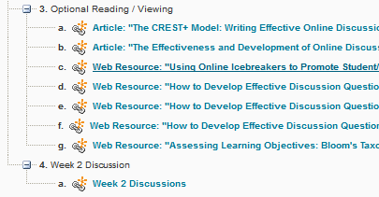
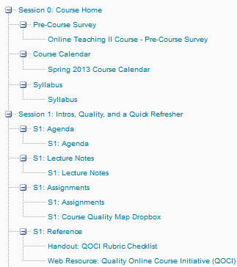
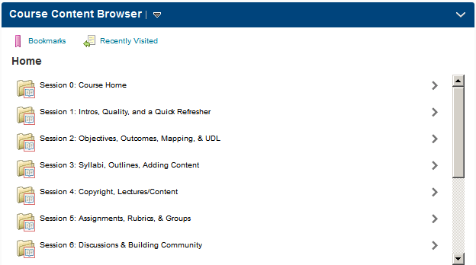
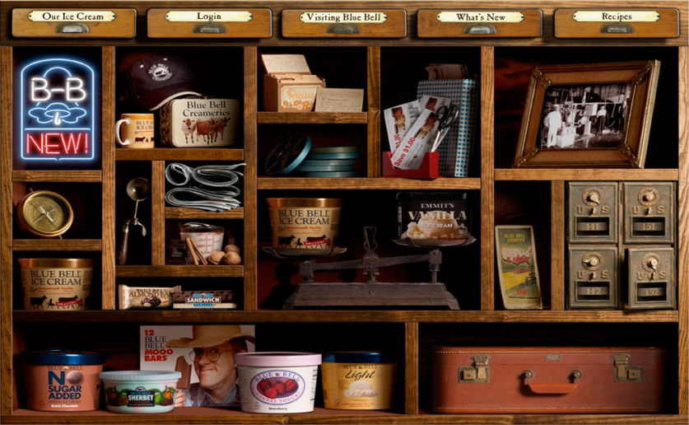
usability
70: Quicklinks in Content | 71: Make Students Stumble
72: Some, More, Most | 73: Avoid Mystery Meat

Slide 20
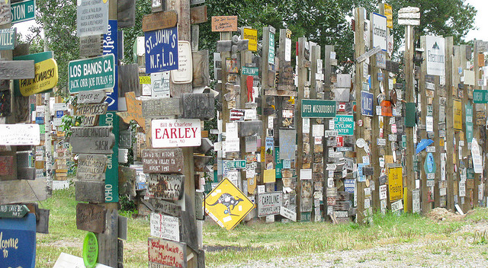
usability
74: Tell, Telling, Told | 75: Ordering for Success
76: Signposts | 77: Agendas
78: Checklists:

Slide 21
universal design
79: Start with Text | 80: Create a Script
81: Say It Twice | 82: ALT

Slide 22
universal design
83: Break It in Pieces | 84: Printables
85: More Essays? Ugh | 86: Transcript It

Slide 23
universal design
87: Sing to Me | 88: Accept More Forms
89: Point Outside | 90: Play It Again, Sam
91: Chunk:

Slide 24
game-based learning
92: Who Am I? | 93: Secret Devils
94: Write Your Own | 95: Basketball

Slide 25
game-based learning
96: Invest in the Syllabus | 97: Monopoly Money
98: Tag | 99: Hidden Keys

Slide 26
game-based learning
100: Easter Eggs | 101: Bonus Levels
102: Special Characters | 103: Badges

Slide 27
game-based learning
104: Always Be Batman

Slide 28
Getting from 104 to 3
We will review the strategy names on the next slides.
On the page below, check THREE strategies about which you’d like to hear more. http://goo.gl/XqSpPd

Slide 29
ice breakers
1: Discussion Topic
2: Audio Intros
3: 10-Second Video
4: Most Recent Picture
5: Separated at Birth?
6: Cartoon Me
7: Blog Sharing
8: Real-Time Chat
9: Farthest, Closest
10: First Job
11: Not My Picture
12: YouTube
13: Rhyming Introductions

Slide 30
student engagement
14: Virtual Pizza-n-Beer
15: Peer Lead
16: One-Paragraph Report
17: Super-Mini Quiz
18: Re-Write It
19: Checklists
20: Syllabus Quiz
21: Classlist “Tag”
22: Assignment Re-Write
23: Take Me with You
24: Calendar Items
25: Devil’s Assignment
26: Progress-Check News

Slide 31
instructor presence
27: News Items
28: Discussion Posts
29: Audio Clips
30: Video Check-Ins
31: “Voice Mail”
32: Audio Assignment Feedback
33: Audio Lecture “Bits”
34: Video Lecture “Bits”
35: Video Postcards
36: Discussion Wrap-Ups
37: Personalized Feedback
38: My Picture in the Syllabus
39: Posting Everywhere at Least Once

Slide 32
interactivity
40: Scavenger Hunt
41: Telephone Game
42: Thought Exercises
43: Switch Thinking
44: Opposites Discussion
45: Stop and Think
46: Butts Out of Seats
47: Look Around You
48: Build, Photo, Post
49: Non-Boring Groups
50: Chat
51: Quizzes about Quizzes
52: Must Post to See Others

Slide 33
academic integrity
53: 3-to-1 Pools
54: Sanction Statements
55: Sign Here, Please
56: Plagiarism Checking
57: Special Browsers
58: Trust
59: Identify
60: Verify
61: Real-Time Monitoring
62: View User Progress
63: Challenge Questions
64: Design for Application
65: Expect Resource Use

Slide 34
usability
66: Pick 3 Elements
67: Text Appearance
68: Follow This Path
69: Modules, Modules, Stop
70: Quicklinks in Content
71: Make Students Stumble
72: Some, More, Most
73: Avoid Mystery Meat
74: Tell, Telling, Told
75: Ordering for Success
76: Signposts
77: Agendas
78: Checklists

Slide 35
universal design
79: Start with Text
80: Create a Script
81: Say It Twice
82: ALT
83: Break It in Pieces
84: Printables
85: More Essays? Ugh
86: Transcript It
87: Sing to Me
88: Accept More Forms
89: Point Outside
90: Play It Again, Sam
91: Chunk

Slide 36
game-based learning
92: Who Am I?
93: Secret Devils
94: Write Your Own
95: Basket-ball
96: Invest in the Syllabus
97: Monopoly Money
98: Tag
99: Hidden Keys
100: Easter Eggs
101: Bonus Levels
102: Special Characters
103: Badges
104: Always Be Batman

Slide 37
and the winners are …
https://docs.google.com/forms/d/1AsEPpPUWAHsN9AwERMz5_mewr-CdWEhIwbpz79sgQ48/viewanalytics

Slide 38
thank you!
t-tobin@neiu.edu

