Slide 1
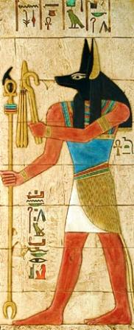
Risk Conversations:
Best Practices for Becoming Change Shepherds on Campus
Thomas J. Tobin
Northeastern Illinois University

Slide 2
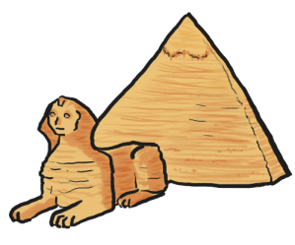
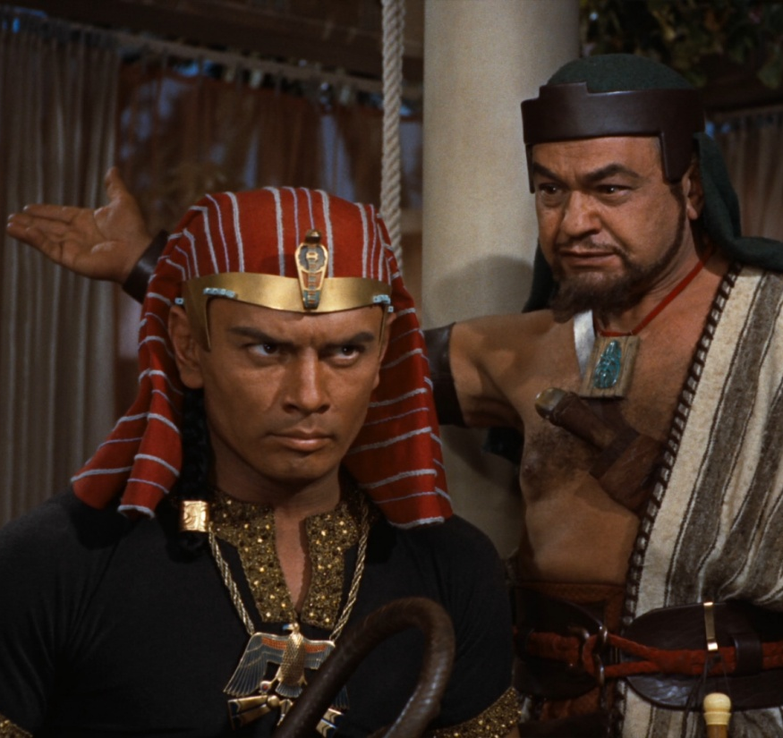
Thought Exercise: Pharaoh’s Bling
?
Pharaoh has chosen you to build a fitting monument to his eternal glory.
What risks are associated with starting, and then keeping the project going?
P.S.: Don’t make Yul Brynner mad!
you
Pharaoh

Slide 3
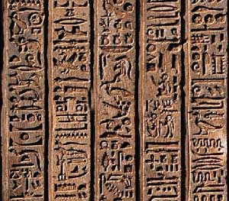
Who’s here today?
Let’s customize our session based on our roles and industries.
Who Are We?

Slide 4
Well . . . Did You Know?

Slide 5
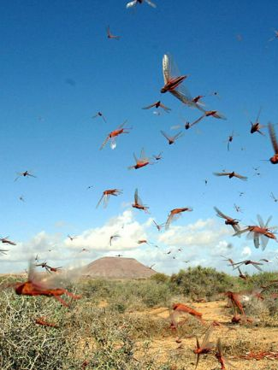
Risk refers to any uncertain event.
Issues are factors that are well known in advance (e.g., funds need to be approved), while risks are the uncertainties in the project.
What’s a Risk?

Slide 6
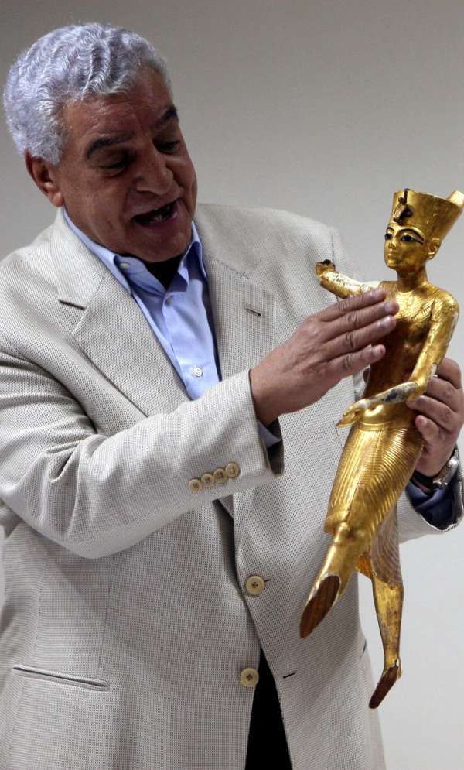
Risk can be positive or negative.
We all know what negative risks are: the risk is that something will go wrong.
Positive risk is taking a chance in order to achieve a benefit or savings.
Positive and Negative Risk

Slide 7
 | Integration | Scope | Time | Cost | Quality | Human Resources | Communications | Risk | Procurement
Initiating | Develop Project Charter |  |  |  |  |  | Identify Stakeholders
Planning | Develop Project Management Plan | Collect Requirements Define Scope Create WBS | Define Activities Sequence Activities Estimate Activity Resources Estimate Activity Durations Develop Schedule | Estimate Costs Determine Budget | Plan Quality | Develop Human Resource Plan | Plan Communications | Plan Risk Management Identify Risks Perform Qual/Quant Risk Analysis Plan Risk Responses | Plan Procurements
Executing | Direct and Manage Project Execution |  |  |  | Perform Quality Assurance | Acquire Project Team Develop Project Team Manage Project Team | Distribute Information Manage Stakeholder Expectations |  | Conduct Procurements
Monitoring & Controlling | Monitor & Control Project Work Perform Integrated Change Control | Verify Scope Control Scope | Control Schedule | Control Costs | Perform Quality Control |  | Report Performance | Monitor & Control Risks | Administer Procurements
Closing | Close Project or Phase |  |  |  |  |  |  |  | Close Procurements
Project Management Processes

Slide 8
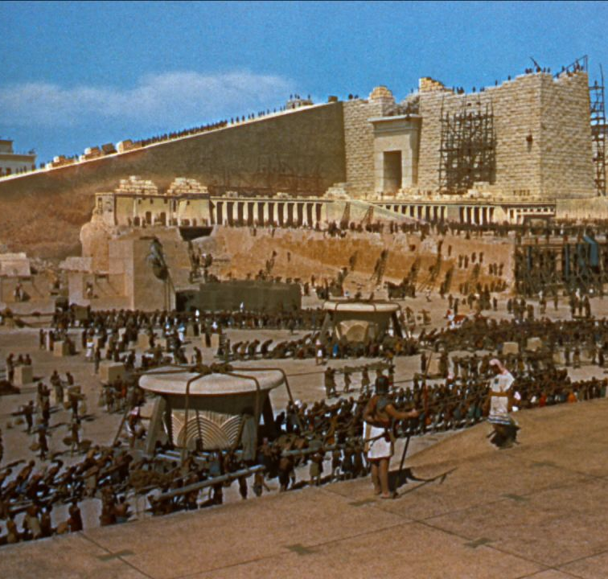
Framing the Task: Pharaoh’s Bling
Okay, people. Break’s over!
What would happen if things went other than as expected?
How many elements could you remove from the project before the objective is endangered?

Slide 9
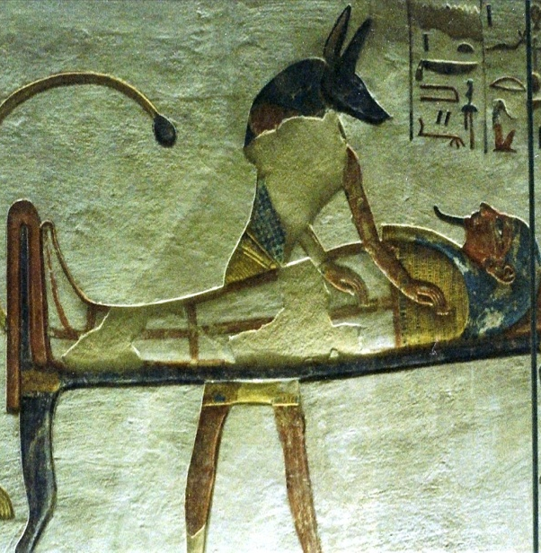
Imagine that the project is completed, and that it has failed. What could have caused the failure? Think about:
Integration
Scope
Time
Cost
Quality
Resources
Communication
Procurement
The Pre-Mortem

Slide 10
Once you have all of the major tasks defined for the project, do a “back of the envelope” risk assessment.
Find out which tasks are critical and which are not by removing individual tasks from the project, and assessing the impact.
Remove One Element

Slide 11
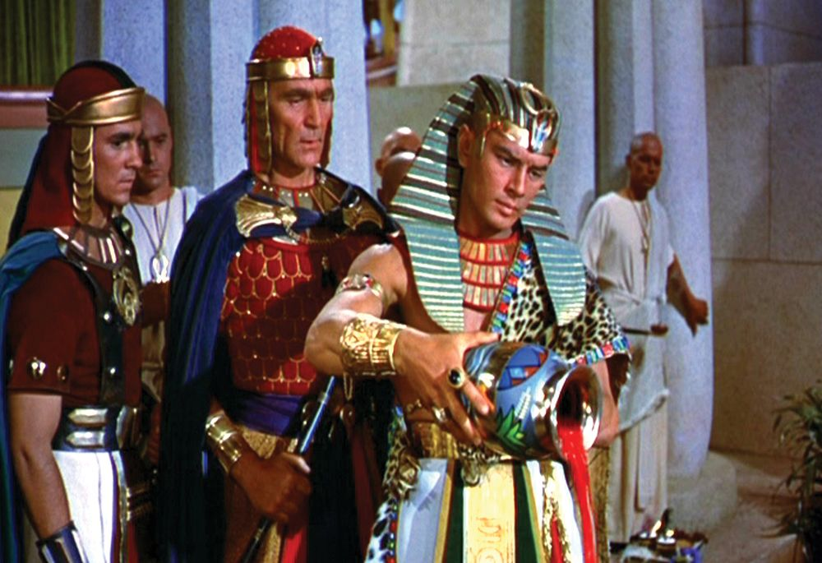
Preparing for Risks: Pharaoh’s Bling
Um, is that blood?
Yup. We’re hosed.
What’s likely (and not likely) to happen?
What are (and aren’t) risks?
How will you respond when risks arise?

Slide 12
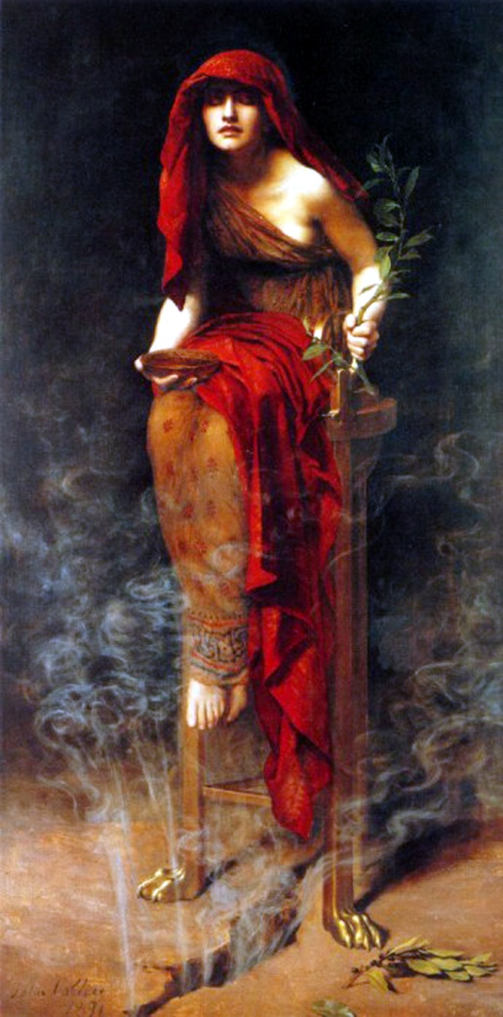
Categorize risks by event, probability, and impact to create a P&I value. Also:
Document Review
Brainstorming
Anonymous Expertise (Delphi)
Interviews
SWOT Analysis
Assumption Analysis
Flow-Chart/Ishikawa Diagrams
Prioritization: Important & Urgent
Risk Assessment

Slide 13
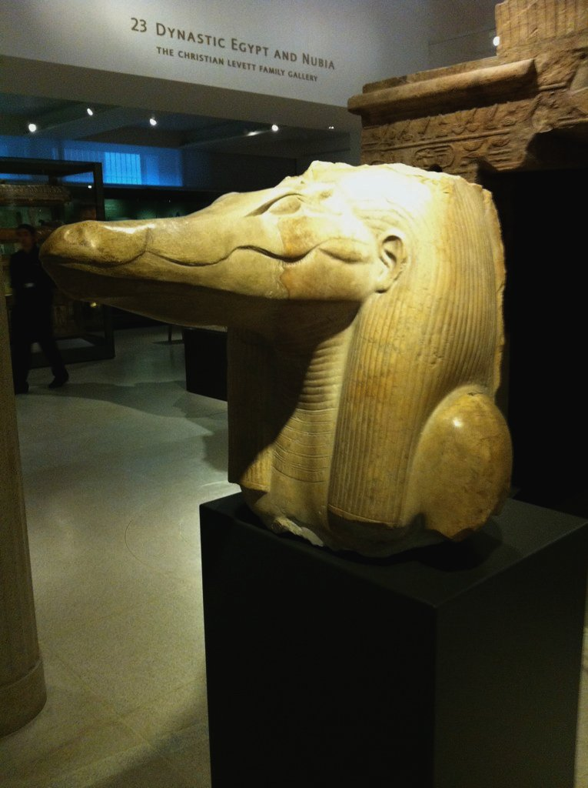
Once you have a P&I value for the known risks, prioritize them:
Deal only with important & urgent.
Plan for what’s likely.
Communicate with stakeholders about possible risk responses.
Evaluate both negative and positive risks with stakeholders.
Risk Prediction

Slide 14
Strategies for negative risks:
Avoid
Transfer
Mitigate
Accept
Strategies for positive risks:
Exploit
Share
Enhance
Accept
Risk Management

Slide 15
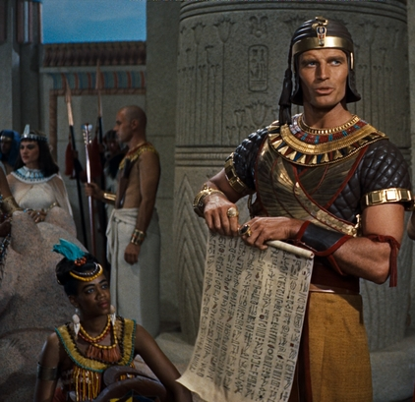
Implementing a Plan: Pharaoh’s Bling
I hope they like the sun porch I added.
What good outcomes do you want to achieve?
Who in your institution can help you to communicate about risks?

Slide 16
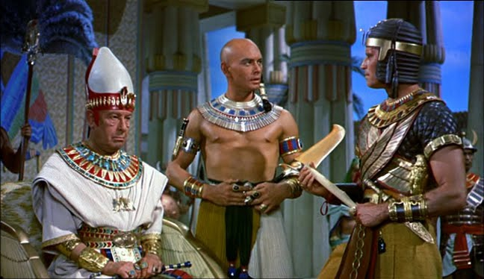
Here we go again…
So let it be written!
In order to monitor and control risks, plan to communicate:
Hold status meetings.
Report on trend analysis results.
Create a “chain of communication.”
Share a risk register.
Customize data for stakeholders.
Create feedback loops.
Communicating Risk

Slide 17
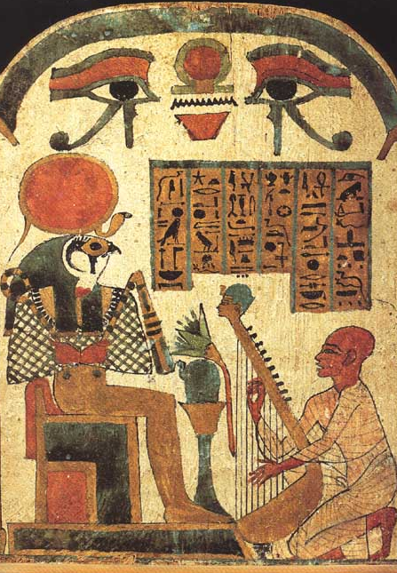
Strategies for risk conversations:
Set expectations.
Bring the data.
Let the stakeholders lead.
Behaviors for change shepherds:
Ask first (with suggestions).
Determine group risk acceptance.
Freedom to Risk

Slide 18
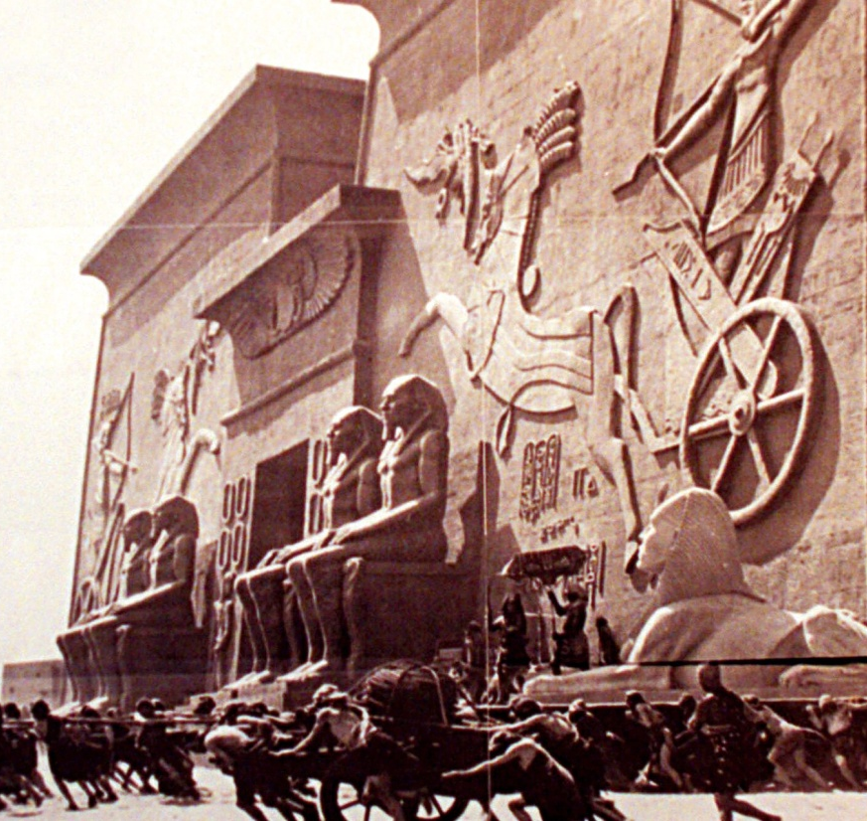
Take-Aways: Pharaoh’s Bling
Why does traffic always slow down in the Fort Pitt Tunnel?
What did you learn from Pharaoh that you can use in your own institution?
Share your own risk stories, and say how you’ll become a change shepherd and hold risk conversations at your institution.

Slide 19
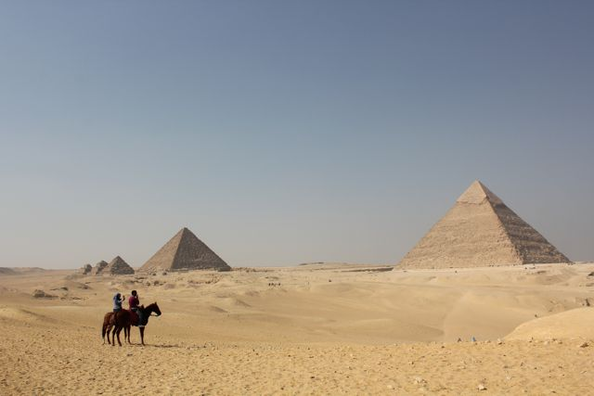
Thank You!
t-tobin@neiu.edu

